Slide 1








2026 Downtown Event Organizer Orientation

Slide 2
Agenda
Timeline Requirements
Permit Types & Applications
City Departments & Contacts
Safety & Insurance Requirements
Buildings Dept. for Canopies larger or stages bigger than 401 sq ft.
Code Enforcement inspection for food trucks
Fees & Payment

Slide 3
Downtown Special Events

Slide 4
DOWNTOWN SPECIAL EVENT - REQUIRED DOCUMENTS
✓ Complete Event Application (45+ days before event)
✓ Detailed Site Plan (show fire lanes, booths, stages, portable toilets, trash containers)
✓ Traffic Control Plan (hire approved barricade company)
✓ Notice of Proposed Closure (signed consent from abutting property owners)
✓ Sanitation Plan (post-event cleanup responsibility)
✓ Public Safety Plan (security and emergency procedures)
✓ Event Insurance (certificate from Texas licensed provider)

Slide 5
All DMD required documents need to be prepared and completed 1 year- 45 days or more before your event date. Any missing documents will delay your application and your application will not be processed.

Slide 6
APPLICATION TIMELINE OVERVIEW
Non-Council Item
1 year to 45 days out
Completed Application Submitted – Case Created - Payment made
30 days out
Finalizing
5 days out
Permit Issued
City – Emailed permit
Departmental review begins, revisions, changes, etc.
DMD - Appointment set for signature
Gathering the remaining reviews

Slide 7
APPLICATION TIMELINE OVERVIEW
Council Item (TXDOT)
30 days out (INTERNAL)
With TXDOT for approval
15 days out
Awaiting for documentation from City Clerk
Approval and issuance
1 year to 90 days out
Completed Application Submitted – Case Created - Payment made
Departmental review begins, revisions, changes, etc.
90 days out (INTERNAL)
Completed contract will be submitted to Legal for review
60 days out (INTERNAL)
Placed in City Council Agenda. Once approved then to moves to TXDOT

Slide 8
THREE TYPES OF PERMITS
Downtown Special Event
For: Events on public right-of-way that disrupt traffic flow
Parade Permit
For: Marches, processions, athletic events disrupting traffic
Temporary Use Permit
For: Short-term use of private property for events

Slide 9
Site Map Examples

Slide 10
SITE PLAN REQUIREMENTS
Your site plan must clearly show:
Fire safety functions FDC, Hydrants, Lanes (clearly marked and accessible)
All booths, tents, and vendor locations
Stages and performance areas
Portable toilets and trash containers
Emergency access routes
Barricade and street closure locations
Note: A fire permit may be required depending on structures used

Slide 11
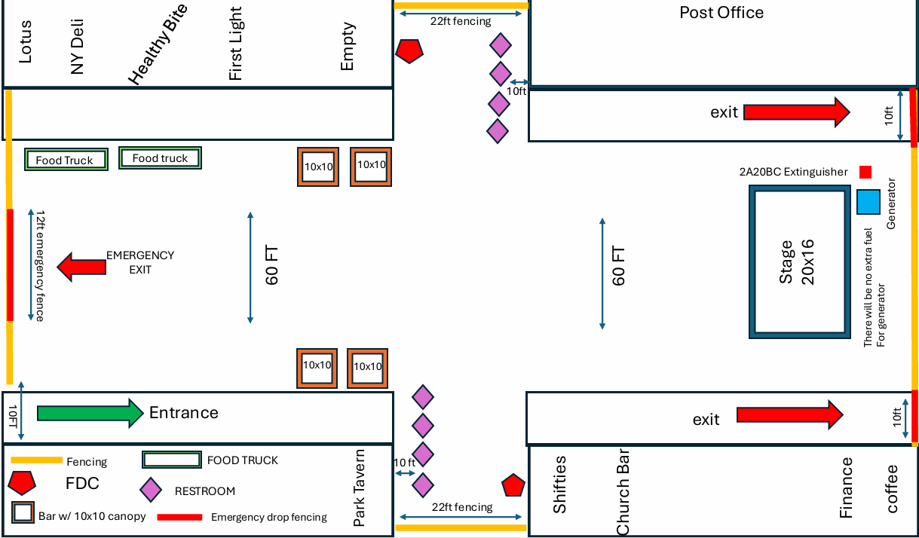

Slide 12
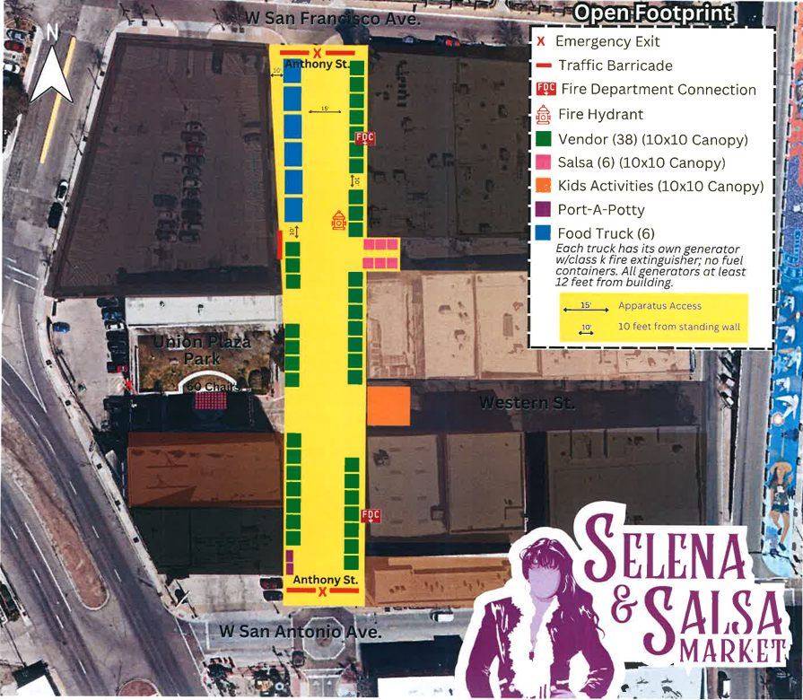

Slide 13
Traffic Control Plans

Slide 14
TRAFFIC CONTROL REQUIREMENTS
Your Responsibility:
Hire an approved barricade company
Provide Traffic Control Plan showing all barricades and signs
Use only ACCEPTABLE barricades (Type III with reflective stripes and warning lights)
Acceptable: Type III barricades with reflective stripes and warning lights
Unacceptable: Cones, simple barriers, unmarked barricades

Slide 15
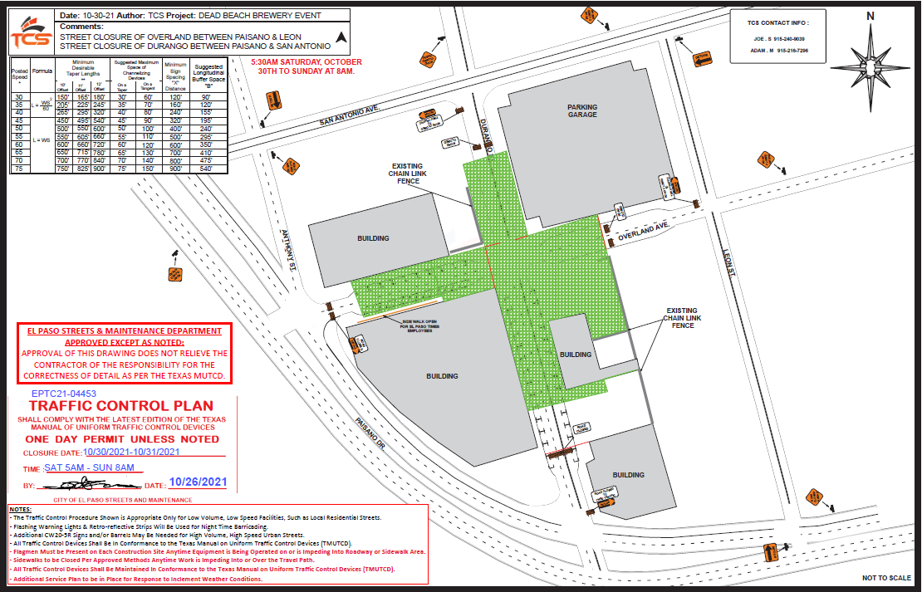

Slide 16
Notice of Proposed Closures

Slide 17
NOTICE OF PROPOSED CLOSURE
You must obtain written consent or acknowledgment from:
Property owners abutting the closure area
Business occupants in the closure area
Neighborhood associations (through authorized officer signature)
Each property requires a signed statement indicating consent or objection

Slide 18
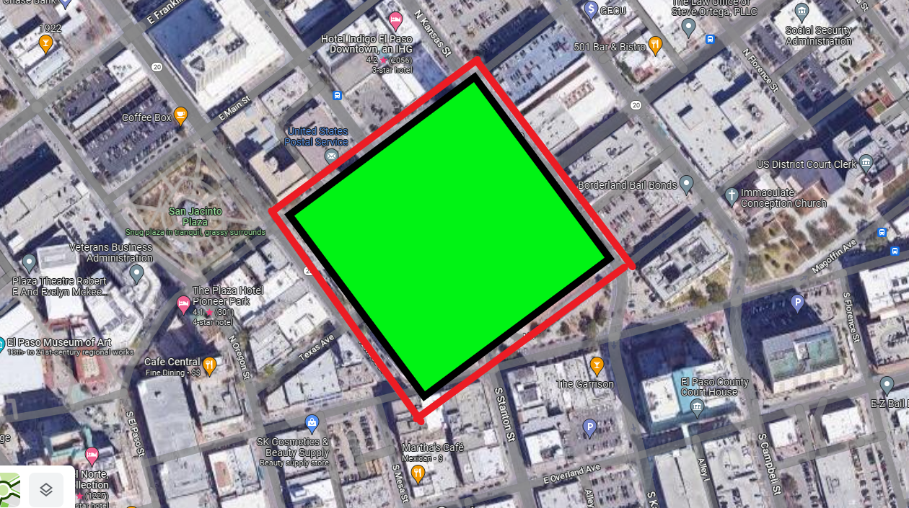
Notice of Proposed Closure

Slide 19
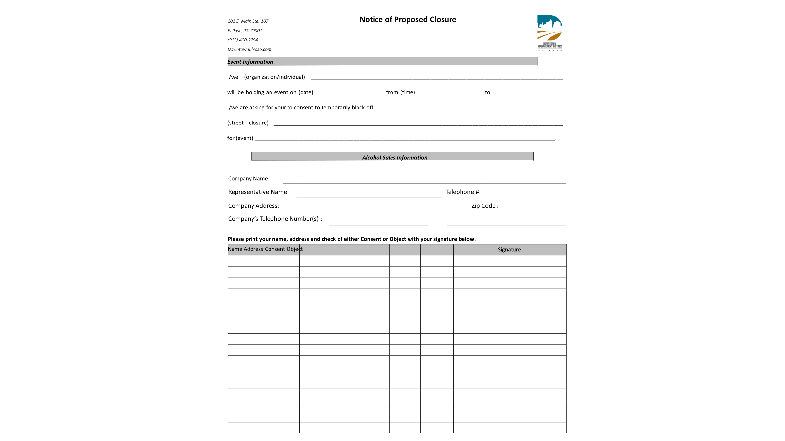
Notice of Proposed Closure

Slide 20
Event Insurance

Slide 21
EVENT INSURANCE REQUIREMENTS
Provider: Must be from a Texas licensed insurance provider
Certificate Holder: Must list City of El Paso
Minimum Coverage:
Liability: $1,000,000 per person
Liability: $1,000,000 per occurrence
Property Damage: $1,000,000
Additional coverage may be required based on event type

Slide 22
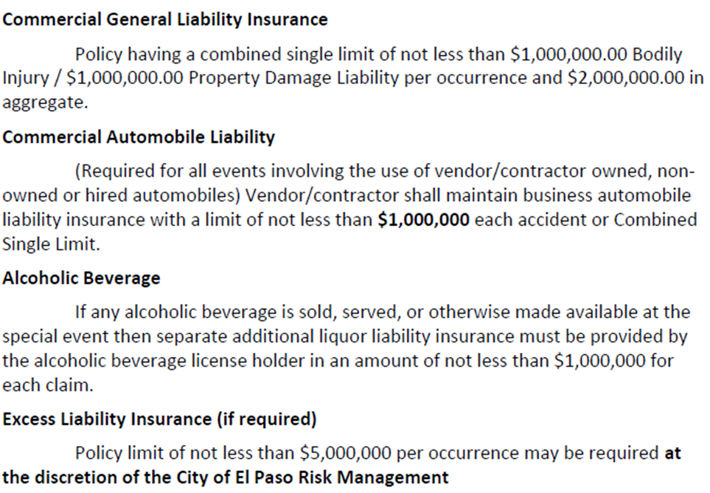

Slide 23
Specific Wording on certificates needed:
All the COIs should have the City of El Paso as the certificate holder:
City of El Paso
300 N. Campbell
El Paso, TX 79901
All the COIs should have the following verbiage which states that the City Of El Paso included as Additional Insured:
City of El Paso their officers, directors, employees and agents. Certificate Holder and all other parties required by the contract are included as Additional Insured on the General Liability Policies, if required by written contract or agreement, subject to the policy terms and conditions.

Slide 24
Parades/ Processions/ Runs

Slide 25
PARADE PERMIT - REQUIRED DOCUMENTS
✓ Complete Event Application (30+ days before event)
✓ Route Map (clear map with route direction)
✓ Business Notification (notify businesses 30 days before)
✓ Turn-by-Turn Directions (detailed route instructions)
✓ Traffic Control Plan (include streetcar right-of-way if applicable)
✓ Letter of Authorization (if using private property)
✓ Application Fee ($137.00 + 1.98% card fee)

Slide 26
TRAFFIC MONITORING FOR PARADES
You must provide traffic monitoring through:
Option 1: El Paso Police Department Fee varies based on event size and streets closed.
Option 2: School Police Department Provide signed letter on department letterhead
Option 3: Sheriff's Department Provide signed letter on department letterhead
Option 4: Licensed Peace Officers Must be Texas licensed, with barricade company
PD estimate based on number of officers, vehicles, and time period needed.

Slide 27
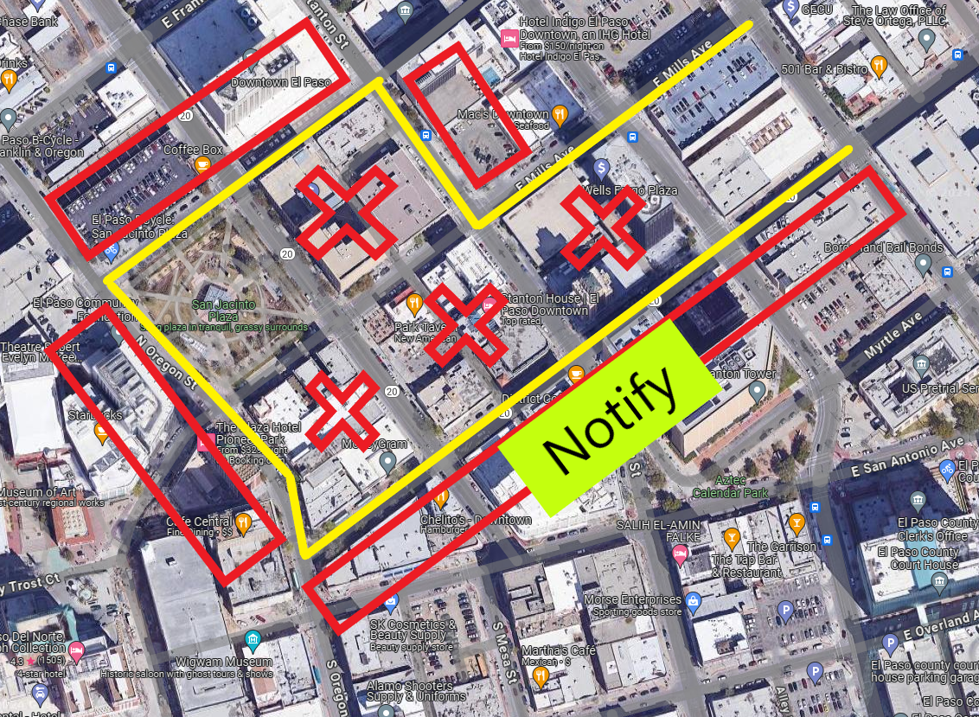

Slide 28
Temporary Use Permits

Slide 29
TEMPORARY USE PERMIT - REQUIRED DOCUMENTS
✓ Complete Notarized Application (30 days)
✓ Property Owner Notarized Form (owner must grant permission)
✓ Detailed Site Map (show entrances, exits, dimensions, restrooms, canopies)
✓ Parking Plan (must provide adequate parking spaces)
✓ Restroom Facilities (portable restrooms if needed)
✓ Security Plan (peace officers or security guards if required)

Slide 30
Temporary Use Permit
Who needs one?
Temporary use permits are short term uses intended to accommodate reasonable requests for interim or temporary uses for a limited period of time on a particular parcel when such activities are desirable for the community. Temporary uses allowed must be consistent with the health, safety and general welfare of persons residing and working in the community, shall be conducted so as not to cause any detrimental effects on surrounding properties and the community, and shall not violate any other ordinance or state and federal regulations.
What is needed?
Complete notarized application packet.
Where do I submit?
SpecialEvents@elpasotexas.gov
When do I need to submit?
Submit 30 days prior to the event date or sooner.
Why do I need one?
To create a safe environment for the event and its patrons.

Slide 31
Temporary Use Requirements
1. Complete event application
  30 days prior to the Temporary Use date
  Incomplete and late applications will not be accepted
  Depending on event- you may need to provide a Texas Licensed Peace Officer(s) or Security Guards for event security. You are responsible for securing this. (30 days before event)
2. Property Owner Notarized Form
  Property Owner must grant permission for the temporary use to take place
3. Detailed Site Map
  Must show entrances/exits, dimensions, restrooms, canopies, etc.
4. Provide Parking Spaces
  Must provide adequate parking spaces
5. Restrooms
6. Event application fee
  30 days prior to the event date: $54.00
  1.98% Credit card fee applies

Slide 32
Fees

Slide 33
Event Fees
Additional Fees:
Applicant is responsible for paying all costs associated with all services performed by the city, including police and cleaning services.
PD may require the hiring of peace officers and/or security personnel.
Applicant is responsible for hiring and paying the peace officers and security officers directly.
PD will request documentation from the peace officer on letterhead to confirm they are providing the traffic monitoring, etc.

Slide 34
 | Downtown Permit Type
Downtown Special Event | $218.00 + $53.00/ +12 hours
Parade Permit | $137.00 | $139.71 (with credit card)
Temporary Use Permit | $54 | $55.07 (with credit card fee)

Slide 35
ADDITIONAL COSTS TO BUDGET
Police Services: Varies by event size, streets closed, duration. Deposit due upon receipt of estimate.
Parking Meters: Per meter, per day rental. Need meter numbers and zone.
Barricade Company: You hire directly. Must provide Traffic Control Plan.
Security/Peace Officers: You hire and pay directly. May be required by PD.
Cleaning Services: Post-event cleanup is your responsibility.
Property Rental: If using city-owned lots or facilities.

Slide 36
Parking Meters

Slide 37
PARKING METER RENTALS
Need to reserve parking meters?
Step 1: Identify Meters Get meter numbers and zone numbers from the meters
Step 2: Call One Stop Shop (915) 212-0104 with dates, times, meter info
Step 3: Pay for Permit One Stop Shop issues permit after payment
Step 4: Attach to Application Include meter permit PDF with event application
Important:
Requests after 2pm cannot be bagged next day
Dual meters require both spots to be rented
Meters bagged day before at 2pm (weekday) or 10am (weekend)
Meters unbagged day after at 6am (weekday) or 6-10am (weekend)

Slide 38
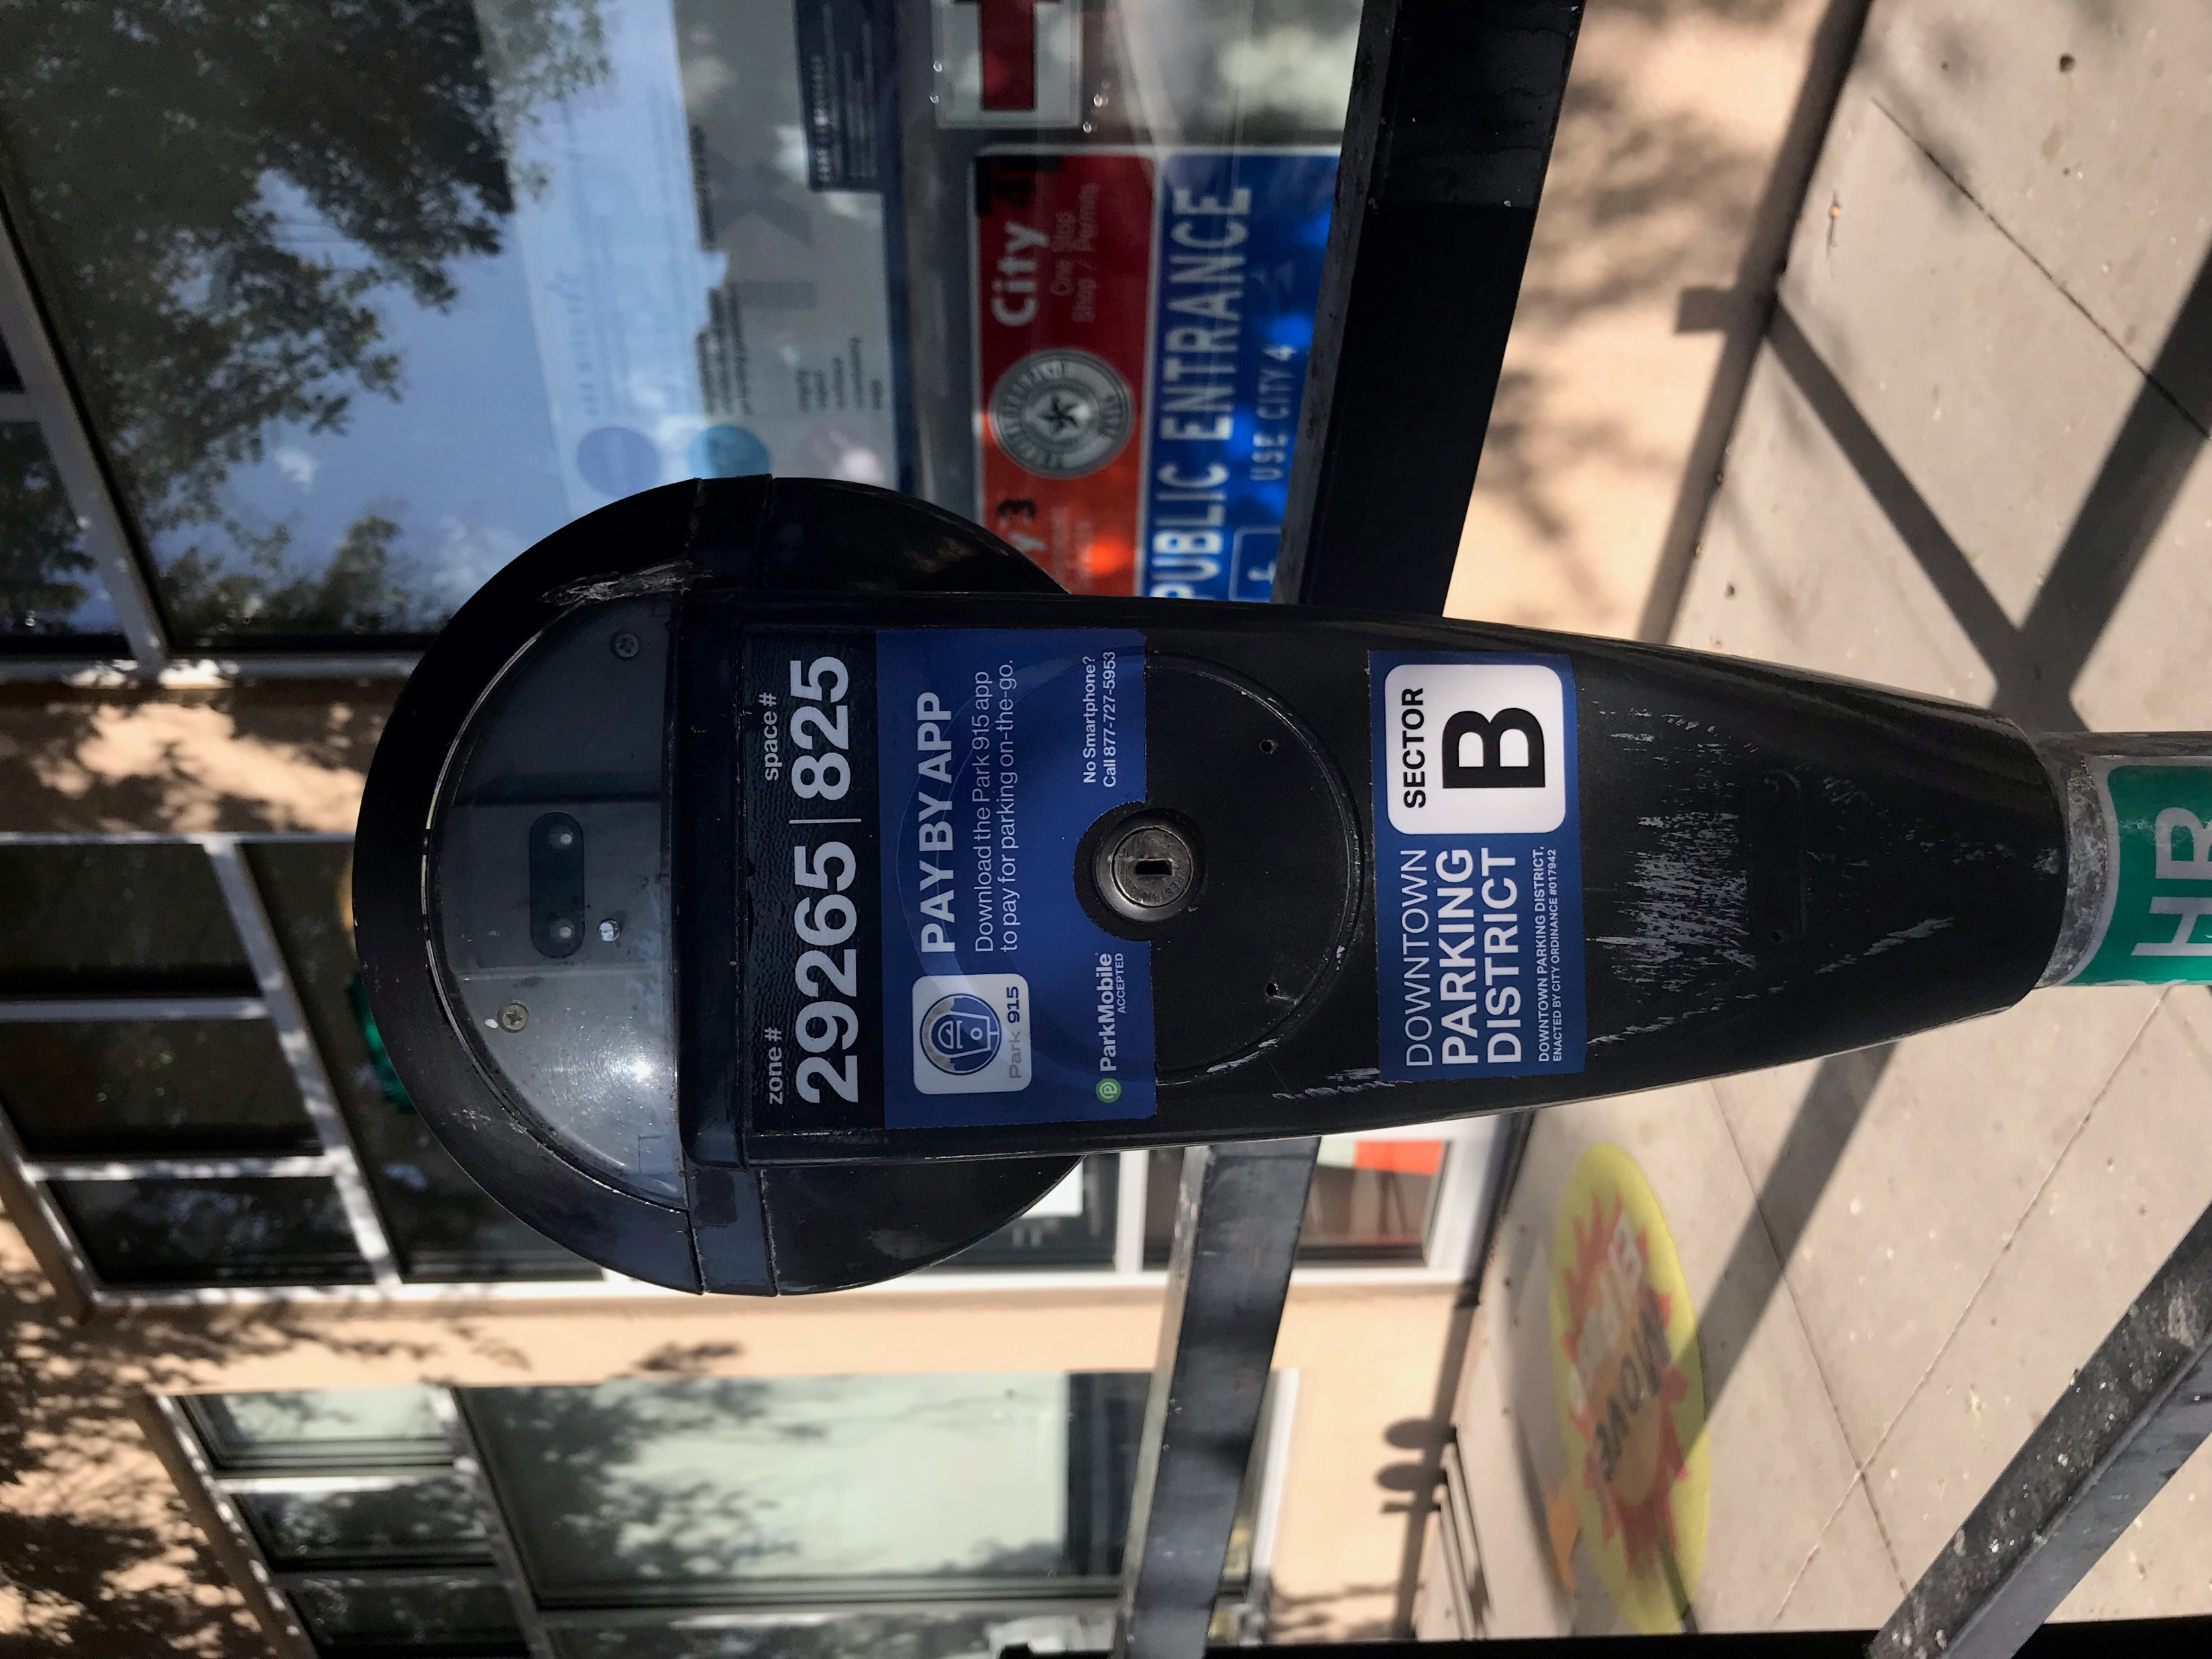
Request is made for a parking meter rental
Customer needs to have the parking meter numbers and meet deadline requirements set by meter rental division.
Ask for the zone number found here
Ask for the space number found here

Slide 39

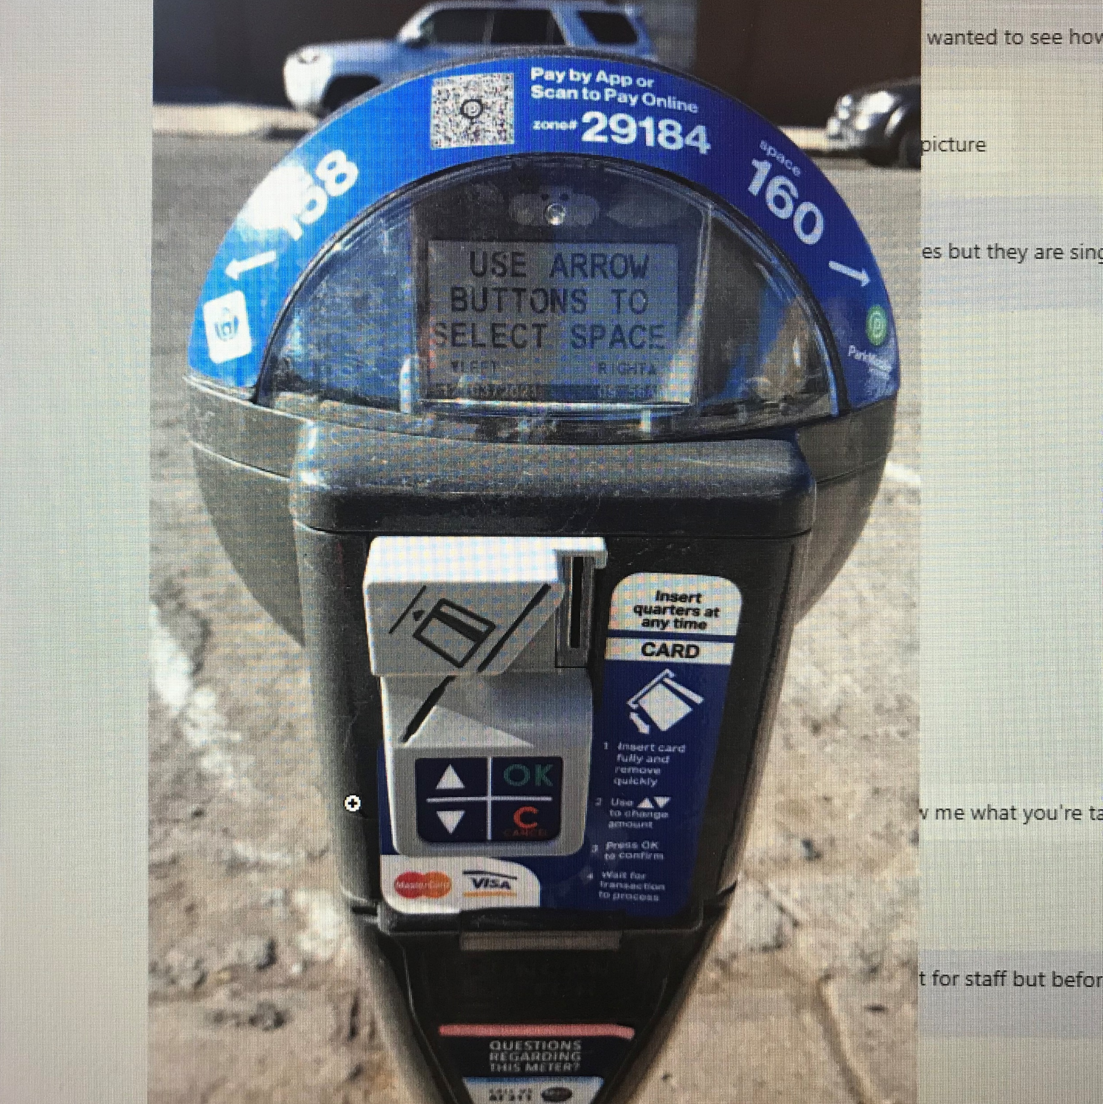
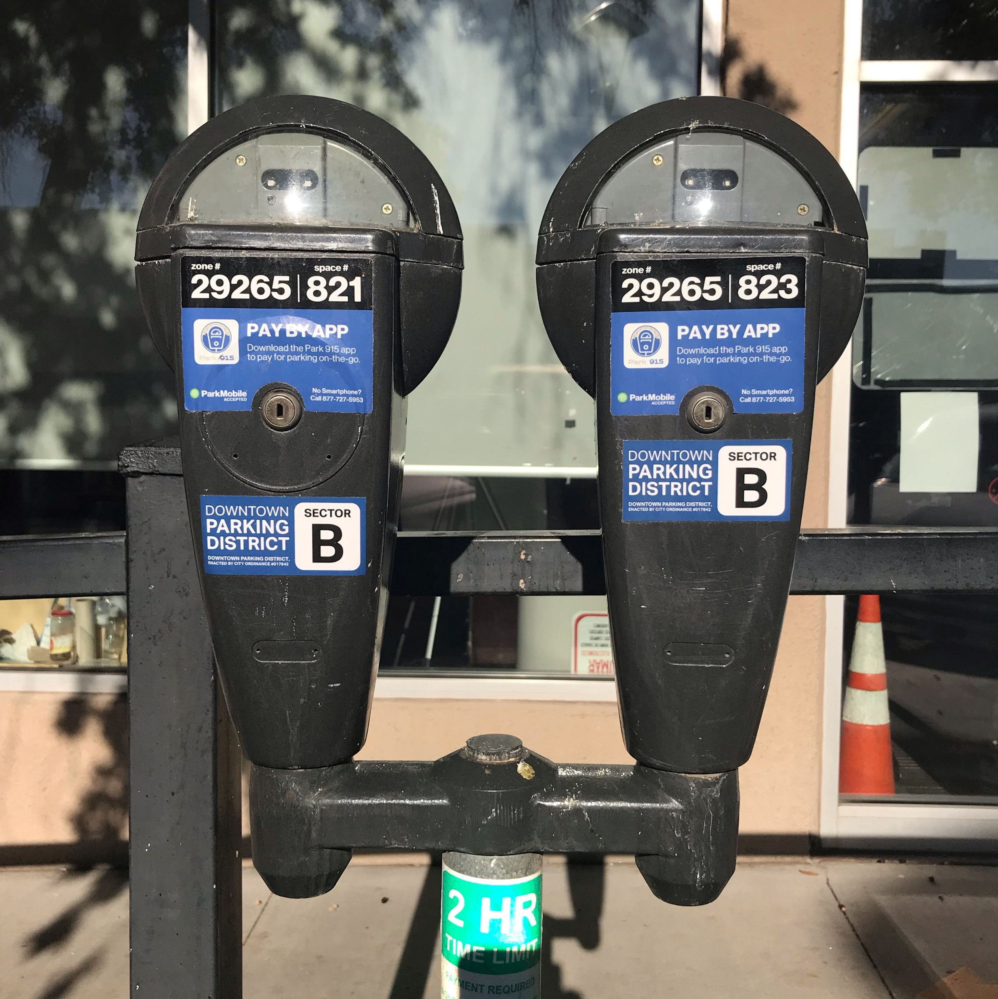
Identification of SINGLE, DUAL, and DOUBLE
Single
Dual
Double
One Pole, One Housing, One Space, installed on one space
CHARGE ONE FEE
One Pole, One Housing, TWO spaces, installed between two parking spaces
CHARGE TWO FEES
One Pole, Two Housings, Has Yoke, installed between two parking spaces
CHARGE ONE FEE PER METER

Slide 40
El Paso Streetcar
Track Access Program

Slide 41
STREETCAR TRACK ACCESS REQUIREMENTS
Working Within 10 Feet of Streetcar Infrastructure? You MUST comply with Track Access Program
Requirements:
Special Events: Submit request 30 days minimum before event
Must provide Traffic Control Plan per Streetcar specifications
Must complete Track Access Training
Must provide Railroad Liability Insurance
⚠️ Missing deadlines = AUTOMATIC DENIAL

Slide 42
Applicability
Any person or entity performing any activity under any Streetcar Infrastructure or within 10 feet of any Streetcar Infrastructure MUST COMPLY with the Track Access Program Procedure as adopted and amended by the Streetcar Safety Officer from time to time.
Activity means the following:
Any construction, demolition, event, moving event, excavation, use of the right of way, cleaning, painting, repairing, or installation of traffic control devices, regardless of whether any of the previous requires the approval of the City under the El Paso City Code; or any activity under the El Paso City Code that requires a permit, license, permission, or review from the City or other regulatory entity.

Slide 43

Track Access Authorization Process
Track Access Request Form (either the Special Event or Non-Special Event application) must be submitted to EPSC within the following deadlines.
  Special Events – 30 calendar days minimum prior to the event.

Slide 44
Track Access Authorization Process
Prior to being granted authority to work or conduct a special event within the EPSC Operational ROW, the Permittee is required to:
Provide a completed Track Access Request Form online
  Non-Special Events Application
  Special Events Application
Provide a Traffic Control Plan in accordance with the Streetcar Specific Typical Applications
Submit one (1) copy of Commercial General Liability with Contractual Liability Railroads Endorsement OR Railroad Protective Liability Insurance
Complete a Track Access Training
Comply with applicable federal, state, local, and EPSC requirements.
FAILURE TO COMPLY WITH THE 45 – DAY REQUIREMENT WILL RESULT IN AN AUTOMATIC DENIAL OF THE TRACK ACCESS REQUEST APPLICATION.

Slide 45
Be Streetcar Safe!
Duke Choi
Transit Senior Service Planner
Office: (915) 212-3430
choidh@elpasotexas.gov
Ahmed Zayan
Transit Service Planner
Track Access Coordinator
Tel. (915) 212-34576
Mobile: (915) 497-7490​
Zayanak@elpasotexas.gov
http://www.sunmetro.net/streetcar/track-access

Slide 46
Franklin Mountain Property Services

Slide 47
Temporary Use Requirements:
Franklin Mountain Property Services
Points of Contact
One San Jacinto Plaza/Mills Plaza/ Kress/ Stewart Title/ Surface and Parking Lots
Amanda Martinez
amartinez@fmmep.com

Slide 48
Temporary Use Requirements:
FMPS for Notice of Proposed Closures
Signatures - when needing a signature of approval for an event surrounding a property.
Required Documents & Information:
Nature of event
Date & time
Usage
Traffic Control Plan (submitted by an approved Traffic Control Company)
Site map for street closure (created by event organizer)
Anticipated number of participants/visitors
# of police and security guards
Additional security officers needed for the event patrolling lot/and or building at the event organizer’s expense to reimburse the landlord. (This is a case-by-case basis depending on the event and officers will be provided by Landlord). Payment will be required at the time of signature, no exceptions.
***All items will need to be prepared before submission for review and at least 30 days before the scheduled event.

Slide 49
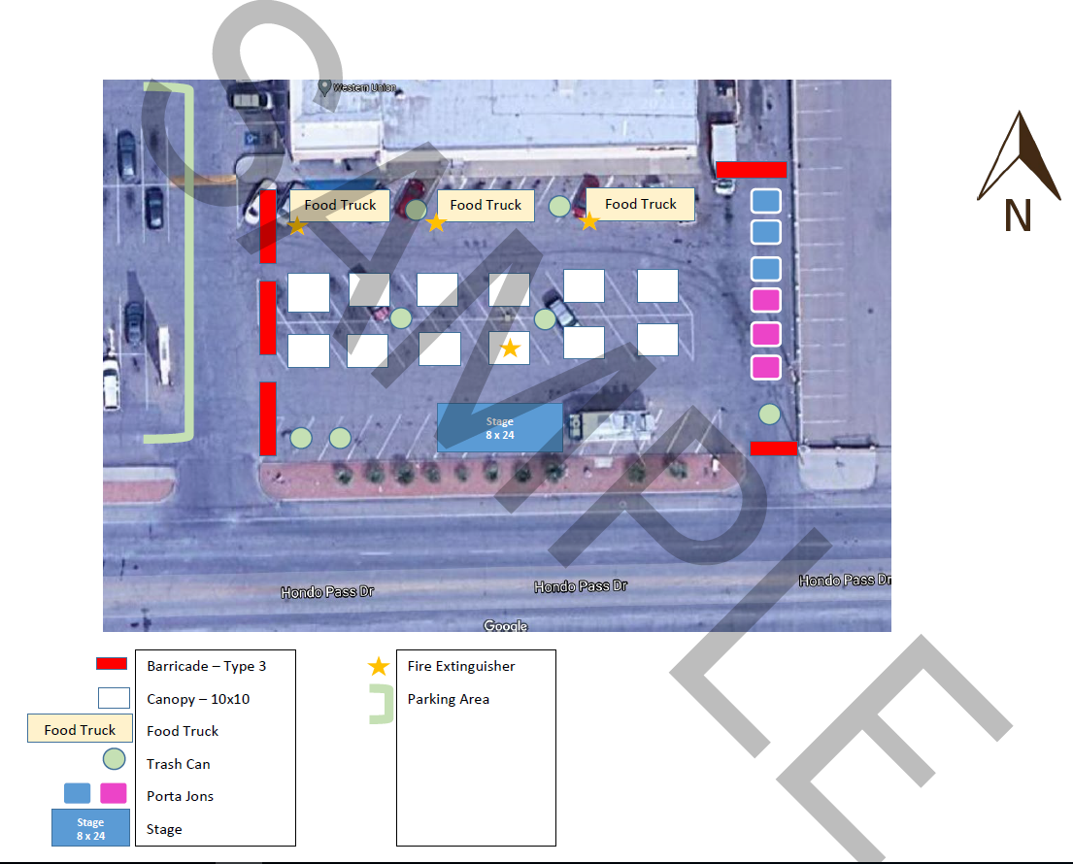
Sample Site Plan for lots

Slide 50
El Paso Police Department

Slide 51
Estimates
Permit requests are to be submitted in a timely manner to ensure an estimate is created. We ask for at least 30 days for review and approval.
The starting point of the event generally determines the Regional Command in charge of the event.
Estimates are based on the need for public safety and the officer’s experience.
  All events require one supervisor, Sergeant or Lieutenant, in charge of the officers providing traffic control.
Minimum number of officers that are needed to provide adequate traffic control and ensure public safety for the event but can change at the discretion of the handling Officer.

Slide 52
Code Enforcement Food Safety

Slide 53
CODE ENFORCEMENT DEPARTMENT – FOOD SAFETY
Applications for Temporary Food Permits must be submitted prior to event.
Applications must be submitted in person at the One Stop Shop – 811 Texas Ave, or via e-mail to foodinspectionpermits@elpasotexas.gov
Inspector will contact vendors on the week of the event to set up an appointment and go over the requirements.
If inspector encounters vendors serving food items without a permit, a Cease Operations Notice and/or Citation will be issued.
For information on fees, please call (915) 212-1510.

Slide 54
El Paso Parks & Recreation

Slide 55
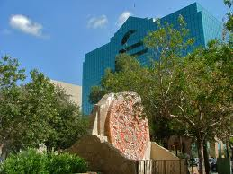
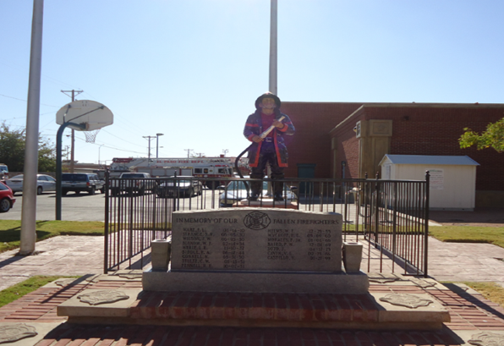
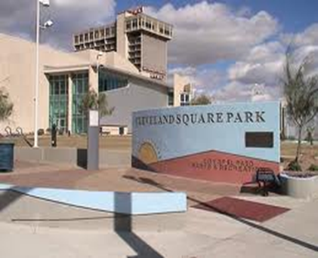
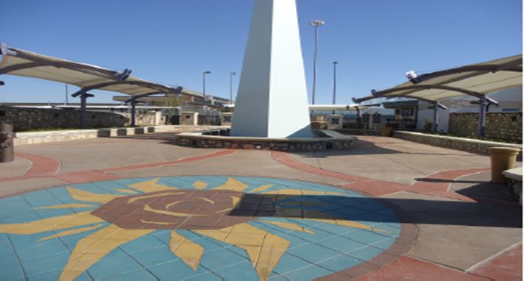
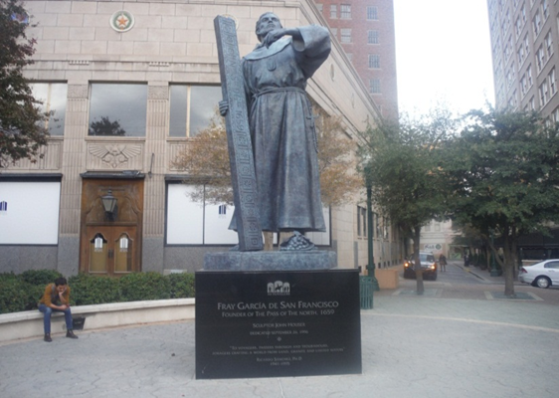
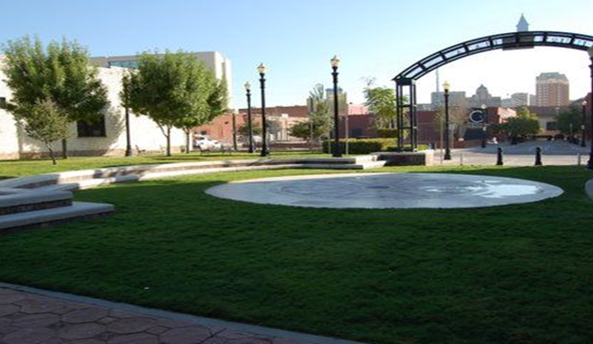
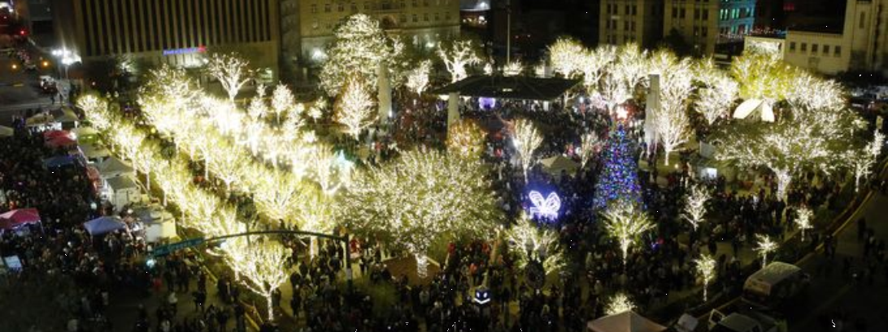
Calendar Park 401 E. San Antonio
316 W. Overland
Firefighters Memorial
Cleveland Square Park
Lions Plazita 910. S. Santa Fe
Pioneer Plaza Mills and El Paso St.
Union Plaza Park 117 Anthony
Arts & crafts spaces
Small stage
Splash pad
Open game areas
Green areas
Special requirements
San Jacinto Plaza
111 Mills St.

Slide 56
Special Events at San Jacinto
Maximum 8 general vendors allowed (NO food vendors on SJP grounds)
Only 10' x 10' canopies/tents permitted
NO STAKING - use sandbags or water barrels only
No jumping balloons, obstacle courses, or mechanical amusements
Site plan must include vegetation protection plan
Parks & Recreation security required for adjacent street events
Electricity use incurs extra fee
Events after 5pm and weekends are considered prime time (higher fees)
Application and fees due 30 days before event

Slide 57
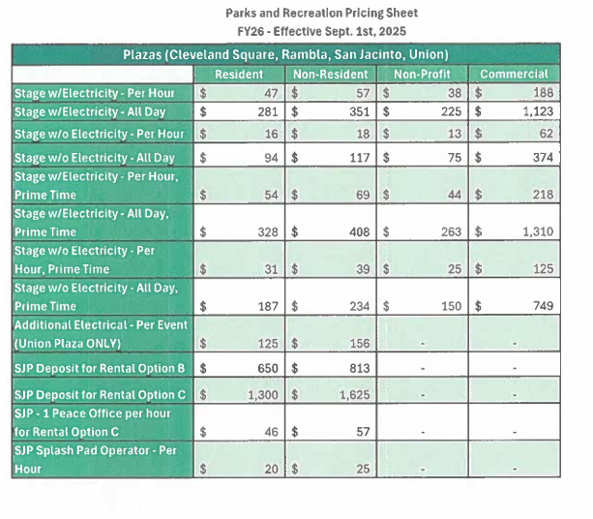

Slide 58
Contact Us
Website:
www.elpasotexas.gov/parks-and-recreation
Office:
801 Texas 2nd floor
El Paso, TX 79901
Joe Gaines
(915) 240-3312
gainesje@elpasotexas.gov

Slide 59
El Paso Fire Department

Slide 60
Topics
Occupant Load
  Detailed Site Plan
Emergency Egress
  Required exits
Location Setup
  Fire Systems
Pyrotechnics

Slide 61
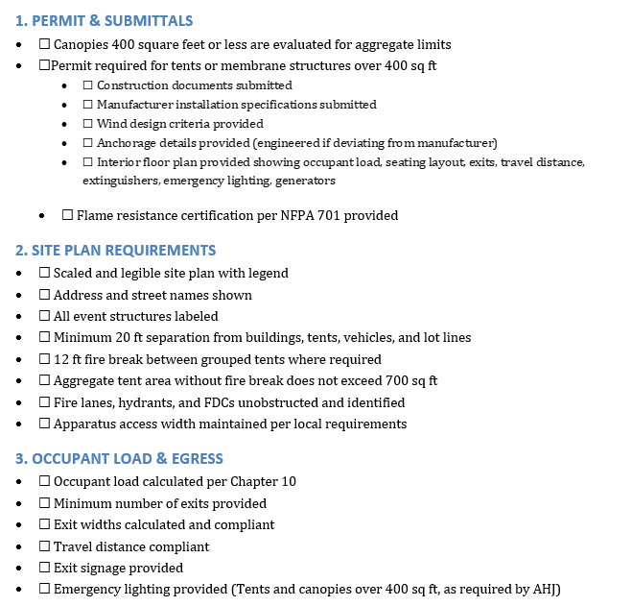

Slide 62
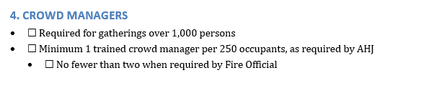
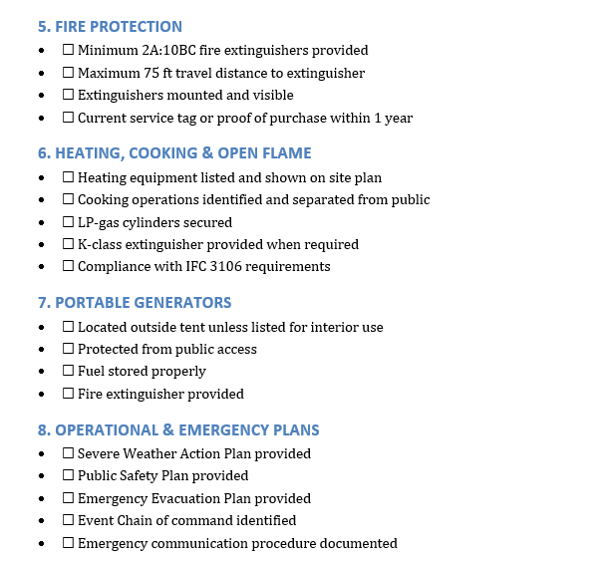

Slide 63
City Buildings Department

Slide 64
Topics Overview
What triggers a building review
What documents need to be submitted
Where does code site the requirements

Slide 65
Texas Alcoholic Beverage Commission (TABC)

Slide 66
ALCOHOL AT YOUR EVENT?
Texas Alcoholic Beverage Commission (TABC)
Separate permit required for serving alcohol
Contact TABC License and Permit Specialist
Plan ahead - additional processing time required

Slide 67


Slide 68


Slide 69


Slide 70


Slide 71


Slide 72
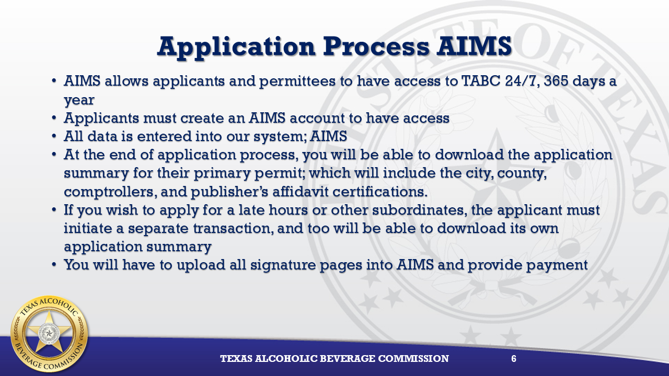

Slide 73
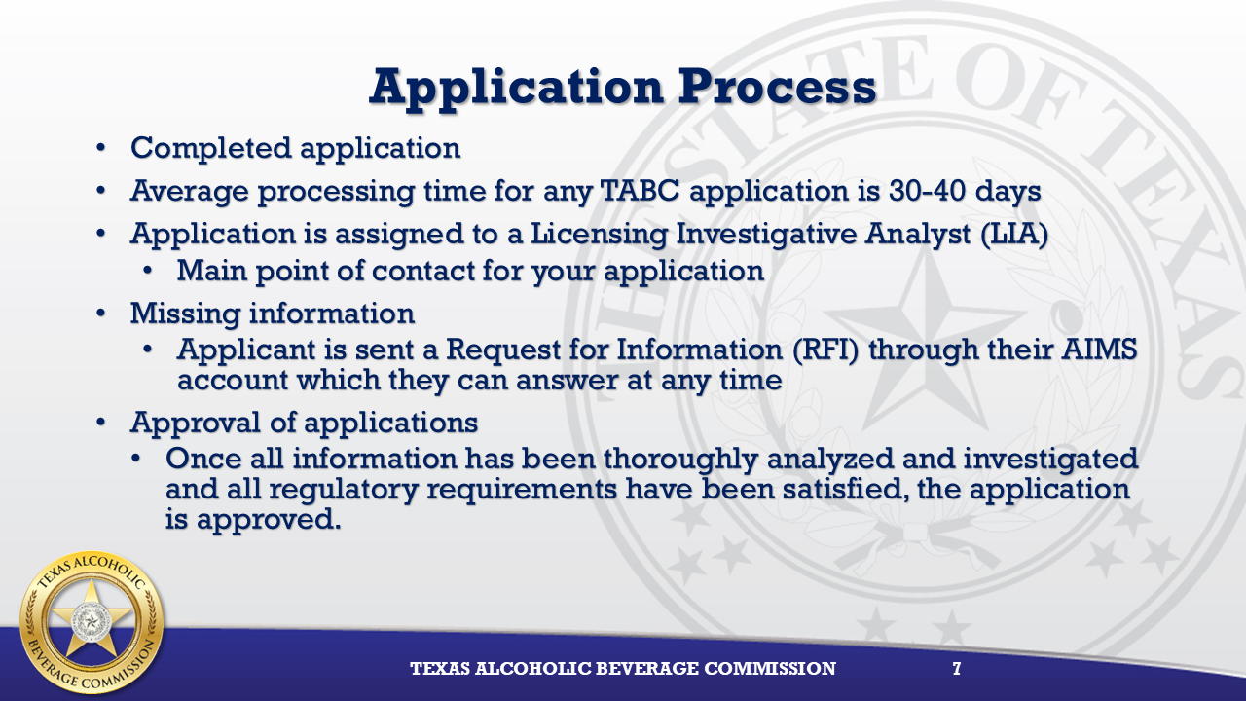
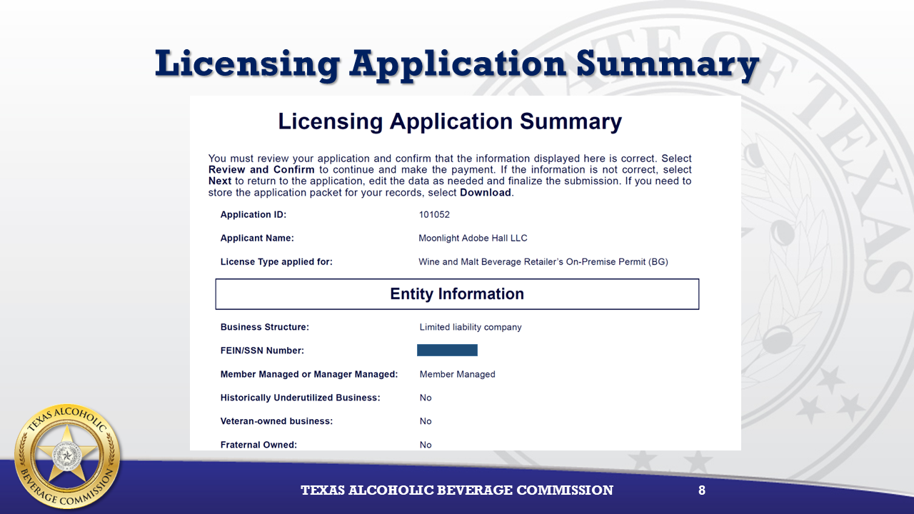

Slide 74
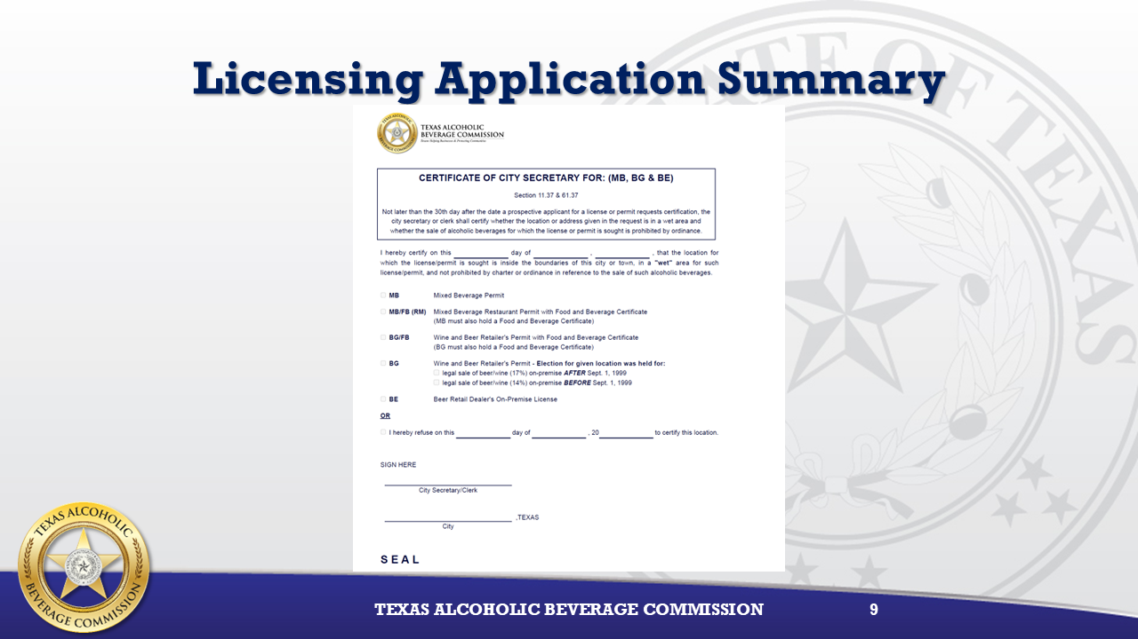

Slide 75
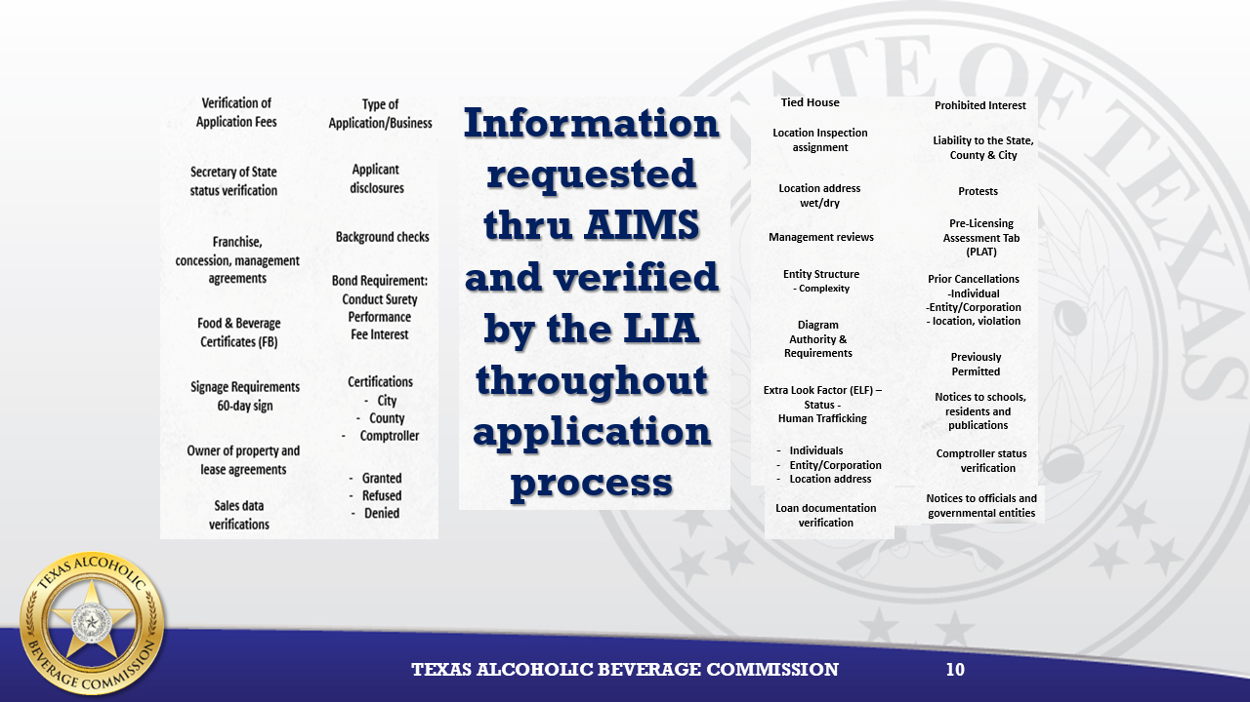

Slide 76
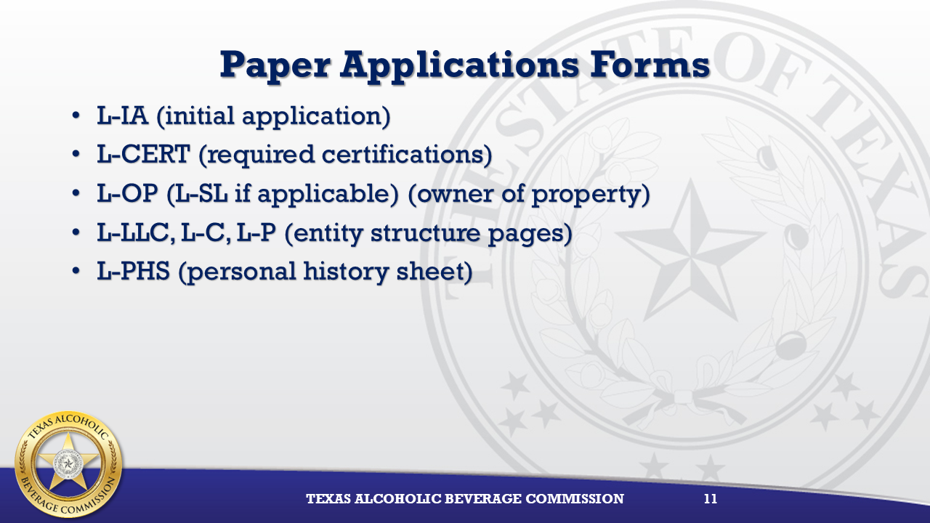

Slide 77
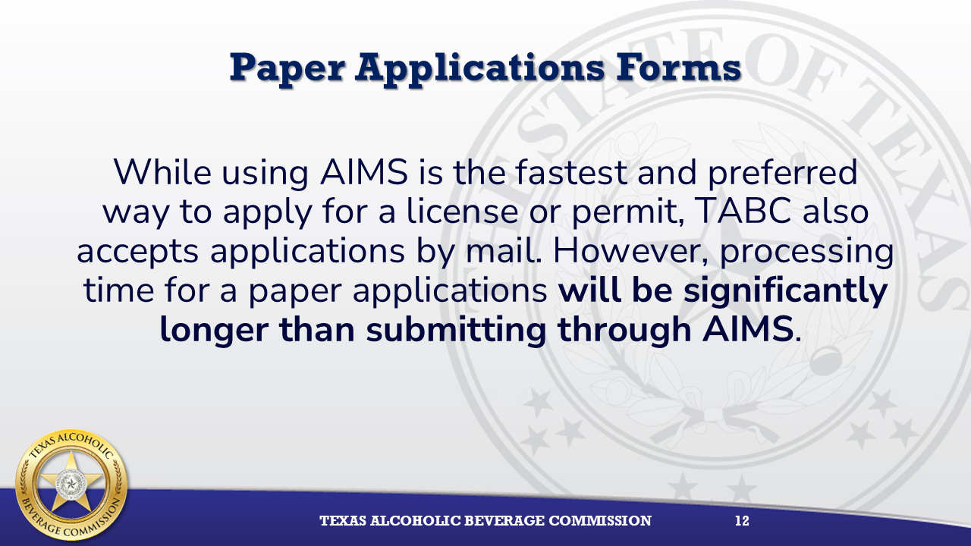

Slide 78


Slide 79
City of El Paso-
Real Estate

Slide 80
Renting a City-Owned Property
RENTING CITY-OWNED PROPERTY
Want to use a city-owned facility, parking lot, or empty lot?
Applications reviewed on first-come, first-served basis
Priority given to established special events (e.g., WinterFest)
No date is secured until final agreement is signed
You are still responsible for acquiring all necessary permits
Submit application early - approval not guaranteed
Contact: Real Estate Office: realestate@elpasotexas.gov

Slide 81
Best Practices for Smooth Approval

Slide 82
BEST PRACTICES FOR SMOOTH APPROVAL
Start Early: Submit 45+ days out, even if you think you need less time
Complete Applications: Incomplete applications will NOT be processed
Clear Plans: Provide legible site plans and route maps with all details
Avoid Peak Traffic: Don't schedule parades during rush hours or wrong-way on one-ways

Slide 83
BEST PRACTICES FOR SMOOTH APPROVAL
Lock Your Route: Route changes after approval may require more officers or denial
Budget All Costs: Remember: police, parking, barricades, insurance, cleaning
Notify Neighbors: Get property owner signatures early - this takes time
Follow Through: Non-compliance can result in denial of future permits

Slide 84
Common Questions

Slide 85
COMMON QUESTIONS
Q: What if I miss the deadline? A: Processing may not be complete by your event date. Will result in denial.
Q: What if I don't comply with permit terms? A: Warnings to denial of future applications. Compliance is taken seriously.
Q: Can I start without permit approval? A: NO. You must have signed approval before your event. No exceptions.

Slide 86
Application Checklist

Slide 87
YOUR APPLICATION CHECKLIST
Before you submit, make sure you have:
✓ Complete application form filled out accurately
✓ Site plan or route map (detailed and legible)
✓ Traffic control plan from approved barricade company
✓ Property owner signatures/consents
✓ Insurance certificate (if required)
✓ Payment for application fee
✓ All supporting documents (parking, TABC, etc.)
✓ Submitted 45+ days before event (30 days for parades)

Slide 88
Key Contacts

Slide 89
KEY CONTACTS
Downtown Management District (DMD)
Ricardo Bustamante (915) 253-4087 rbustamante@elpasodmd.org
For: Downtown special events
Special Events Permits Office
Marisol Franco (915) 212-1563
SpecialEvents@elpasotexas.gov
For: Parade & temporary use permits
Parks & Recreation
Joe Gaines (915) 240-3312
gainesje@elpasotexas.gov For: San Jacinto Plaza & park events

Slide 90
KEY CONTACTS
Streetcar Track Access
Duke Choi 915-212-3430
choidh@elpasotexas.gov
Ahmed Zayan 915-212-3476
Zayanak@elpasotexas.gov
Code Enforcement Food Safety
One Stop Shop (915) 212-1510 foodinspectionpermits@elpasotexas.gov
For: Temporary / Mobile Food Permits

Slide 91
Thank You

